Slide 1
2019-2020 DEC Grant Information Session Administered by: Arts Services Initiative of Western New York Funded by: NYS Council on the Arts

Slide 2
Deadline Friday, September 27 at 11:59PM
Erie County Community Arts Grants
Niagara County Community Arts Grants
Erie County Arts Education Grants
Niagara County Arts Education Grants
Erie County Individual Artist Grants
Niagara County Individual Artist Grants
Electronic submission MUST be RECEIVED by this date and time!
If you have applied for an ASI grant in the past, do not create a new account in the grants portal.
Late submissions will NOT be considered!
**We encourage early submissions for reviewing purposes.
DRAFT REVIEW DEADLINE:
Draft application will be reviewed if submitted by
Wed, September 4 -12:00 PM (Noon)
Completeness, narrative structure and budget.

Slide 3
Eligible Applicants:
Must be 18 years old or older.
Nonprofit Arts Organizations
Arts Organizations that are not non-profits
Government Municipalities
Non-Arts Organizations with arts related programming and events
Coalitions / informal groups
Individual Artists
MUST legally reside or be located in Erie County or Niagara County and program/activity must take place in Erie County or Niagara County.
Projects must take place between January 1, 2020 and December 31, 2020.

Slide 4
NOT Eligible:
Schools
Organizations that have applied to NYSCA or REDC directly for funding for the 2020 fiscal year (be careful with partner organizations).
NYS agencies & departments.
Requests that are for more than 50% of the project’s budget (Community Arts & Arts Education Categories)
Projects NOT open to the public.
Previously funded DEC recipients who have failed to provide final reports, use proper acknowledgement, or have failed to comply with previous contract terms.
INCOMPLETE OR LATE APPLICATIONS.

Slide 5
Funding Categories:
Community Arts Grants: MATCHING GRANT 50%
Minimum: $500
Maximum: $5,000
Arts Educations Grants: MATCHING GRANT 50%
Minimum: $500
Maximum: $5,000
Individual Artist Grants: FLAT COMMISION, NO MATCH NEEDED
$2,500
Community Arts & Arts Education Grants
Up to 3 project requests, no more than $5,000
Individual Artist Grants
Can only apply for 1 in this category.
Can apply in another category (Community Arts & Arts Education Grants), cannot exceed $5,000 total.
Funding Priorities for ALL Categories:
First time applicants or new initiatives from past applicants;
Artist fees & technical production services;
Marketing / publicity costs;
Projects for audiences unable to access programming;
Free or low-cost admission to individuals economically in-need.

Slide 6
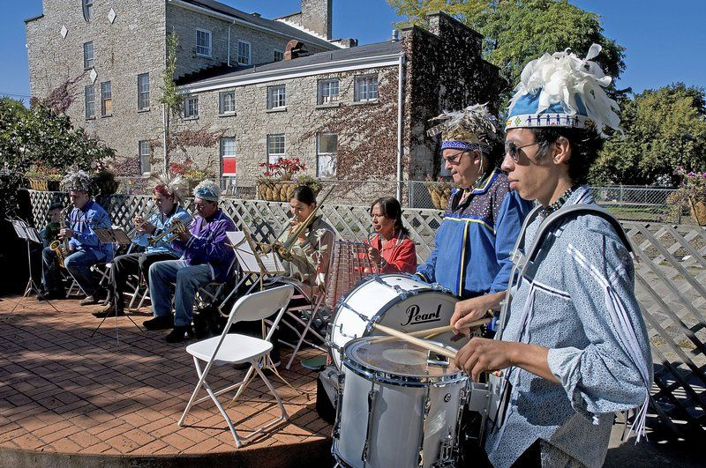
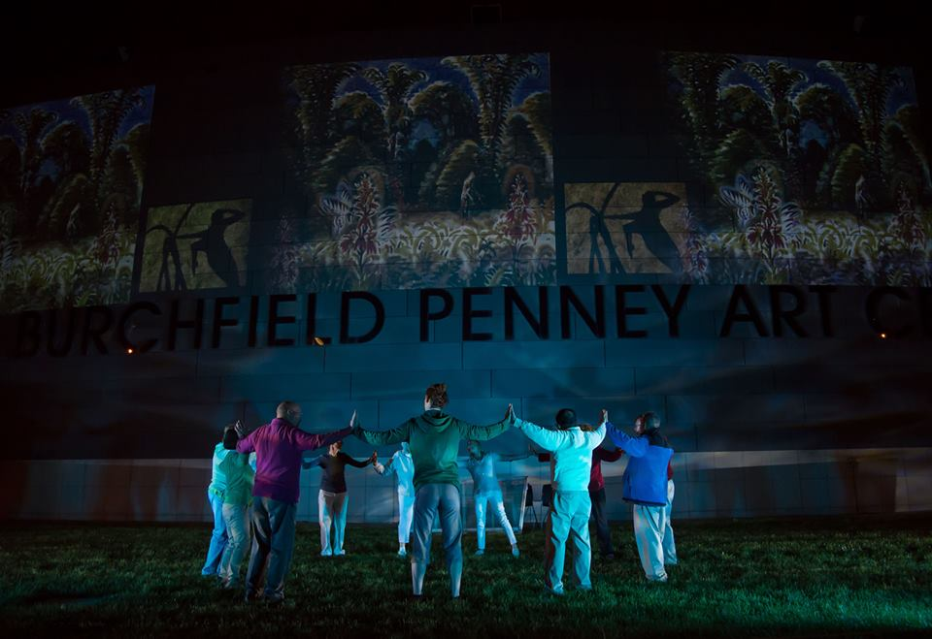
Community Arts Grants:
Matching Grant: Will fund up to 50% of your project’s budget
Community-based arts activities (all artistic disciplines) in Erie or Niagara County
Lewiston Council on the Arts
Earth Voices of the Great Spirit
2019 Community Arts Grantee
Eligibility:
Community Arts grants may include, but are not limited to: exhibitions, workshop series, performances, festivals, screenings or readings. All funded projects in this category must be community based and open to the general public.
Parkinson’s Foundation
“Art Moves Me at Burchfield Penney Art Center”
2019 Community Arts Grantee

Slide 7
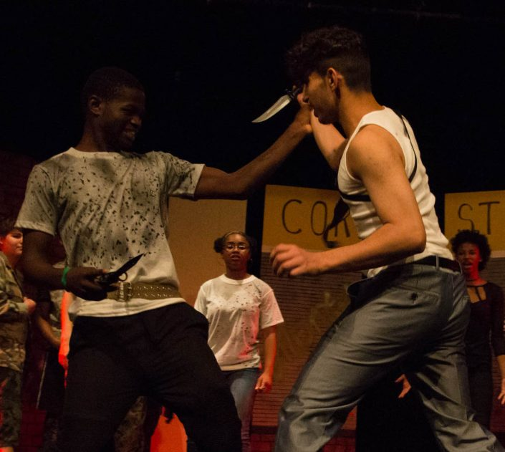
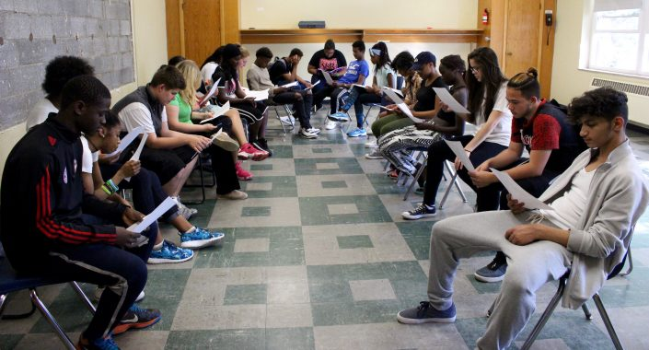
Arts Education Grants:
Matching Grant: Will fund up to 50% of your project’s budget
25% of the county’s total DEC grant funds
Eligibility:
Project must:
Support arts education projects that take place in-school during the school day and/or after-school and community-based settings for grades K-12;
Be carried out in partnership with a public school or a community-based organization;
Develop & implement sequential, skills-based study;
Show hands-on, participatory creation and/or learning opportunities in one or more art forms that may culminate in exhibitions, productions, or demonstrations.
State learning goals, methodologies and outcomes and a means for evaluation
Include a minimum of 3 hands-on learning sessions with students.
A written letter of commitment from the school(s) or community partner is needed.
Peace of the City Ministries
“Shakespeare Comes to 716”
2019 DEC Arts Education Grantee

Slide 8
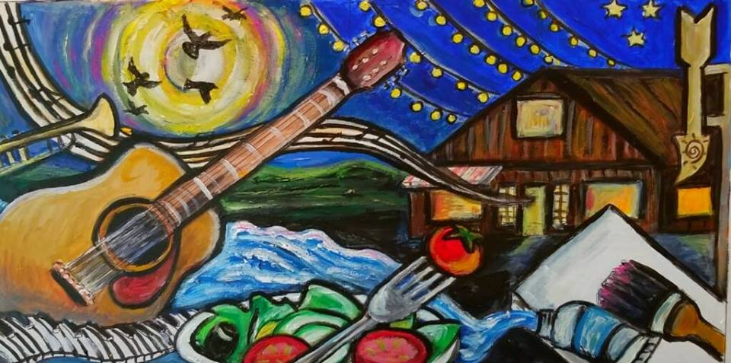
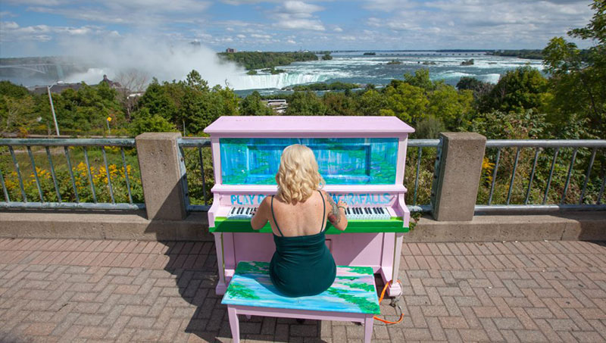
Individual Artist Grants:
Flat Commission $2,500: No match needed
2 Erie County grants AND 2 Niagara County grants will be distributed.
Stacey Lechevet (Erie County)
Community mural for the West Falls Center for the Arts
2019 Individual Artist Grantee
Purpose of Grant:
To create a new work of any artistic discipline that is publicly accessible.
Must engage a segment of the community through a public program, such as an exhibition or performance that is open to the public, and/or the inclusion of community involvement in the development and creative process of the artists’ project.
Projects must take place in the county in which the applicant is located.
Niagara Falls Public Pianos (Niagara County)
2019 Individual Artist Grantee

Slide 9
Review of Application:
https://www.asiwny.org/dec-grants/
What does accessibility mean to you and the community you serve?
Download the ASI budget form and fill it out correctly.
Attachments:
Letters of support are important!
Merge PDF files to include more than 1 page using an online merger for free.
If you’re writing a play, include examples of the script.
If you’re creating a mural, include a depiction of what it will look like (drawing, graphic design, photo).

Slide 10
Steps to Apply
1.
Review Eligibility, Guidelines & Deadlines
2.
Visit ASI Website & create an account or sign into your account if you already have one
https://www.asiwny.org/dec-grants/
3.
Complete the Online Grant Application

Slide 11
Review & Granting Process:
1.
Panel of your peers will evaluate the applications and recommend grantees.
https://www.asiwny.org/wp-content/uploads/2018/12/DEC-Grant-Panel-Roster-2013-2019.pdf
(Late September)
2.
ASI will submit the recommendations to an Advisory Committee made up of your peers and ASI’s Board of Directors.
(October)
3.
ASI’s Board approves the recommendations.
(Early November)
4. ASI will notify you if your application was denied and will offer feedback. Denied applicants may appeal the decision if it fits within the appeals guidelines provided by NYSCA. ASI will respond to appeals.
(November)
5.
ASI will notify you if your application was approved!
(November)
6.
You will sign a contract and upload it to your account in the grants portal. ASI will mail you a check once they receive your contract.
(Early 2020)
7.
You complete a wonderful arts program in Erie or Niagara County!
(Year of 2020)

